Slide 1
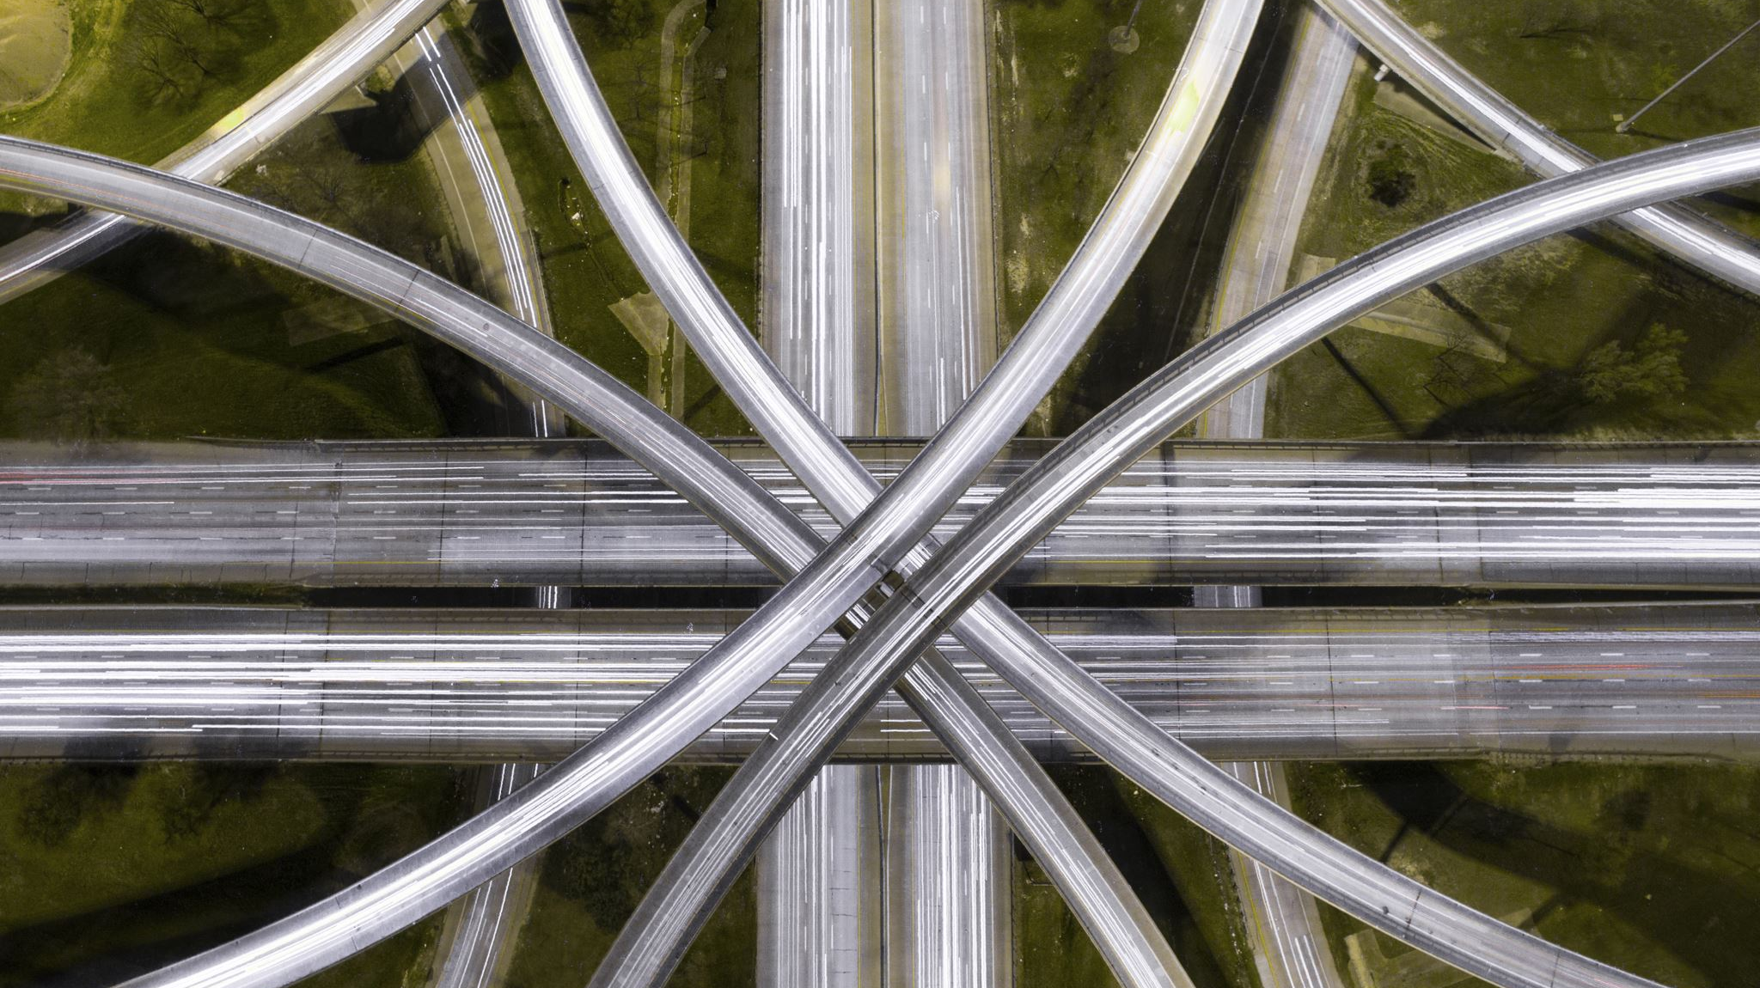
Autonomous Intersection Management (AIM)
By: Charles Arsenal Okere Muhammad Amirul Hakimi bin Zaprunnizam(Amirul) Muhammad Iqbal bin Mohd Fauzi(Iqbal) Muhammad Farid Izwan bin Mohamad Shabri(Farid)

Slide 2
Problem?
Car crashes at intersection point or junction without traffic controls.
Time wasted
Emission

Slide 3
Solution
V2V Protocol = Share datas between one vehicle to another for example speeds,
Total Bandwidth Server Algorithm = Scheduling aperiodic task
Vehicle Collision Warning Communication Protocol
Management Centre/Server Hub to send information
Fcfs

Slide 4
Design
Activity Diagram
State Machine Diagram
Sequence Diagram
Use |Case Diagram

Slide 5
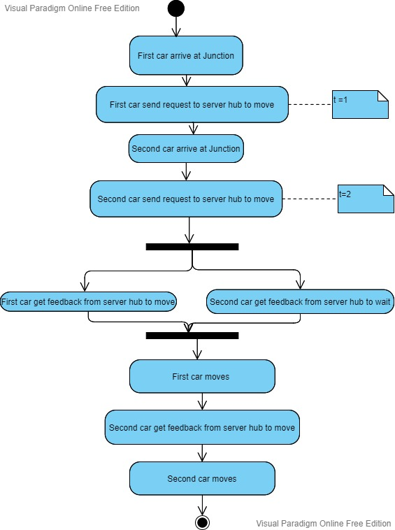
Activity Diagram for car scenario

Slide 6
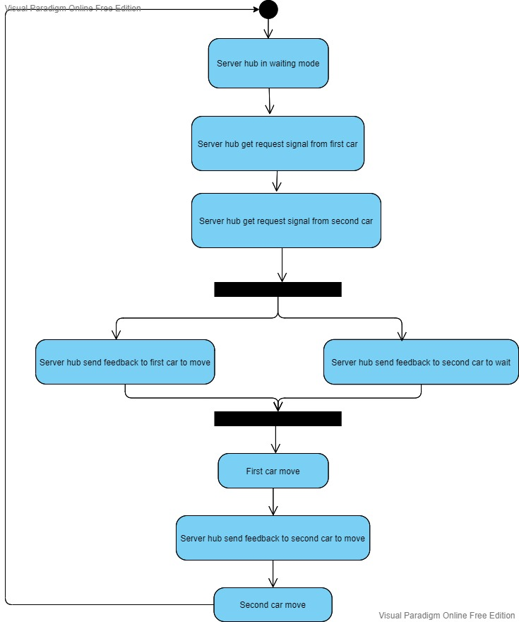
Activity Diagram for server hub

Slide 7
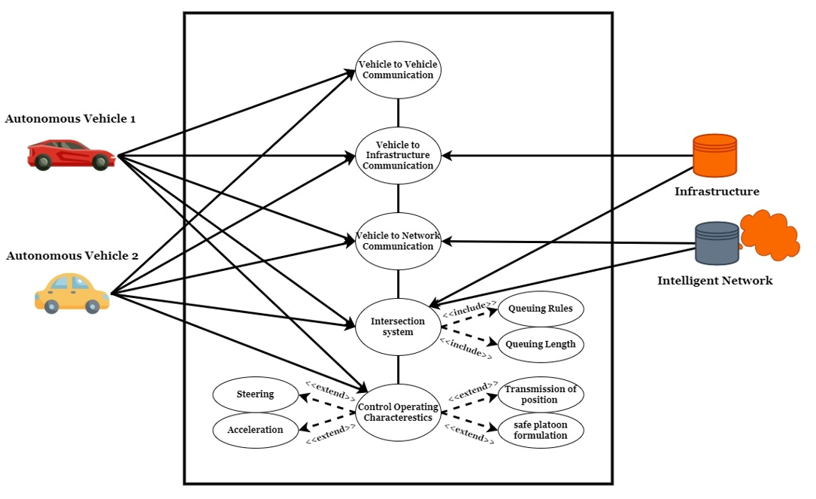
Use Case Diagram

Slide 8
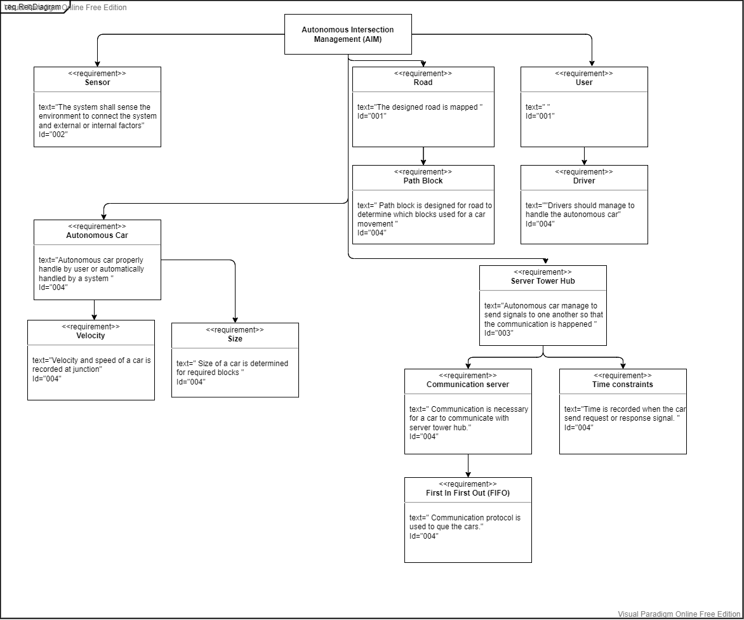
Requirement Diagram

Slide 9
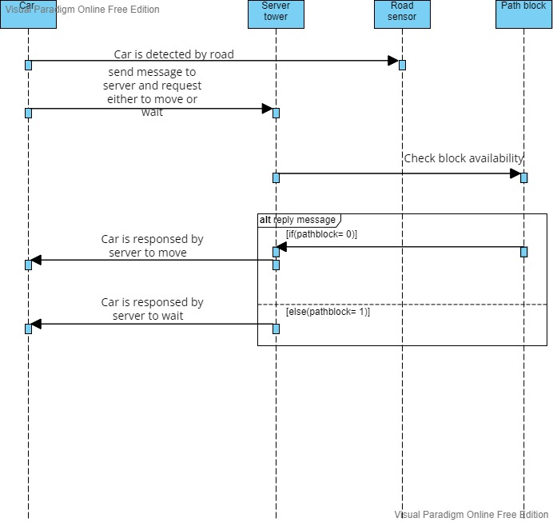
Sequence Diagram

Slide 10
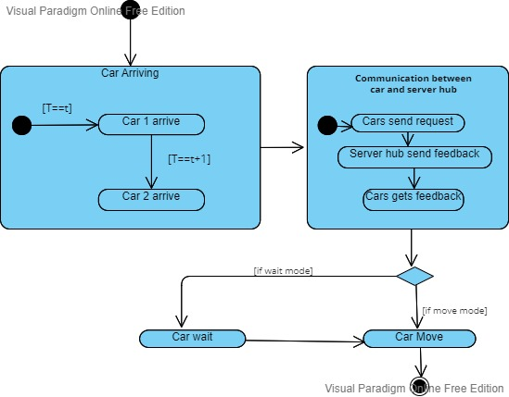
State Machine Diagram

Slide 11
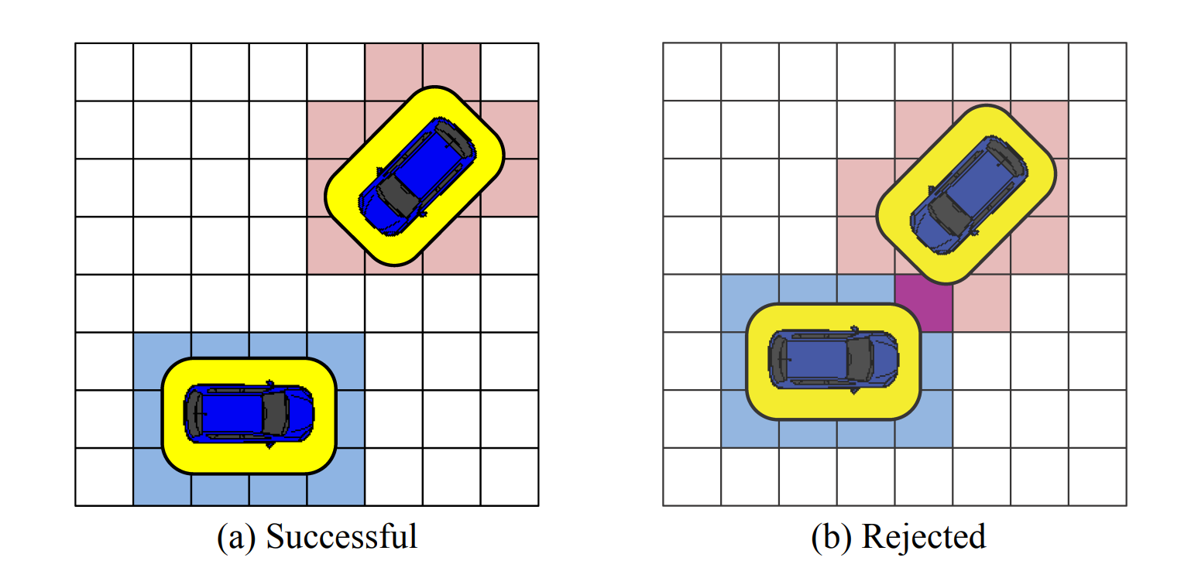
Idea of Path Blocks at 4 junctions

